Slide 1
Neural Machine Translation
Kyunghyun Cho
New York University
Courant Institute (Computer Science) and Center for Data Science
Facebook AI Research

Slide 2
A bit of historical remark
When did neural machine translation start, and where does it fit?

Slide 3
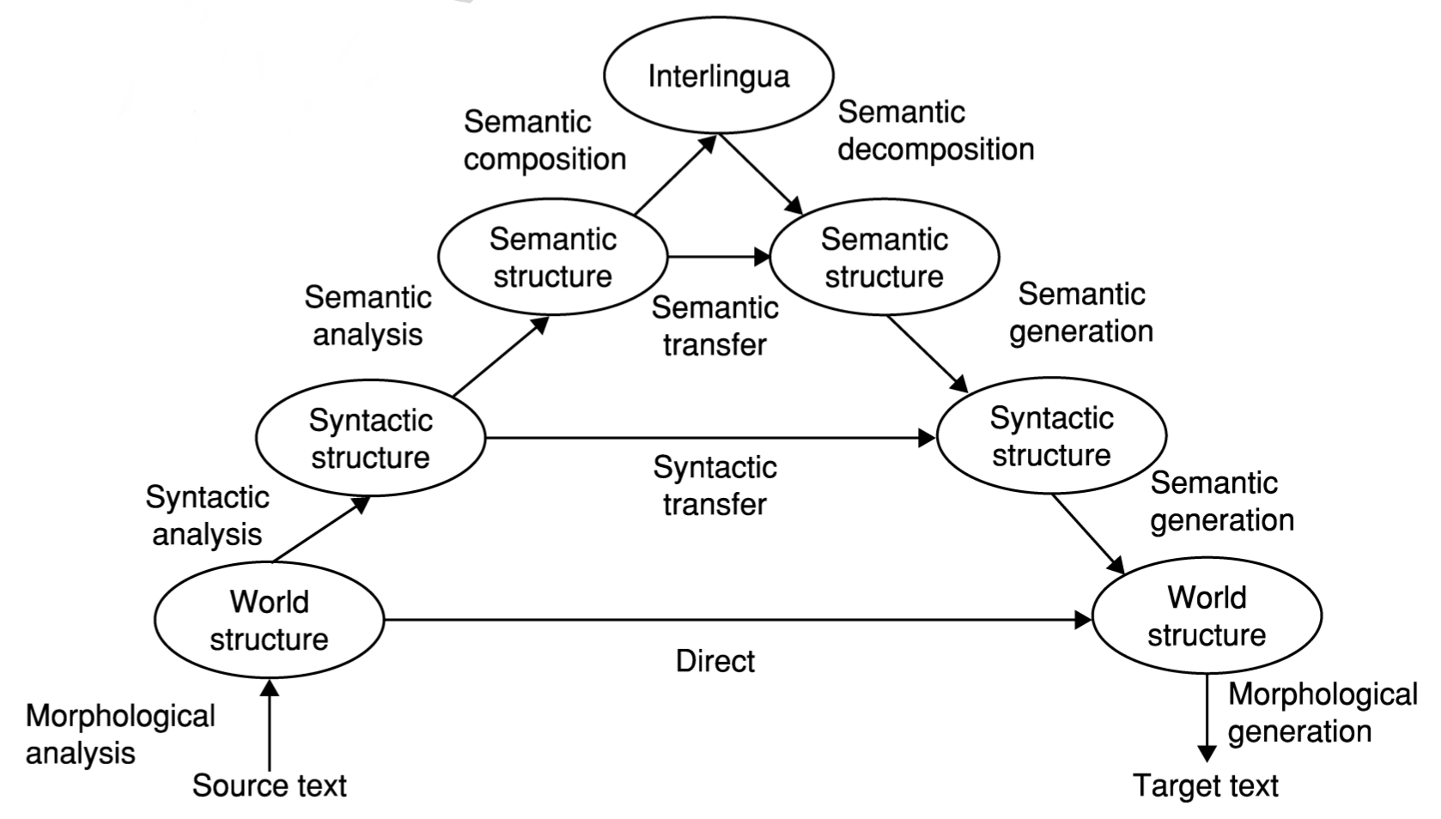
Only if we knew what these were…
Borr, Hovy & Levin (2006)

Slide 4
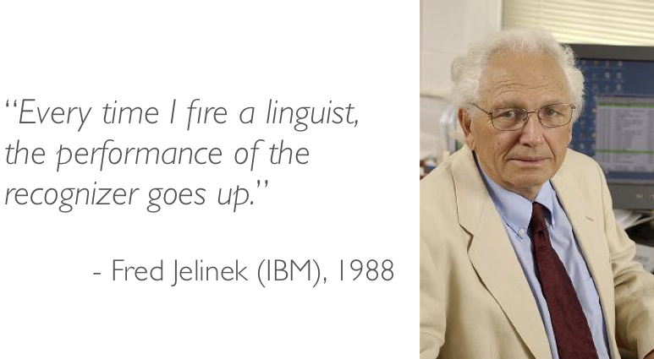
Unfortunately not…
Borr, Hovy & Levin (2006)

Slide 5
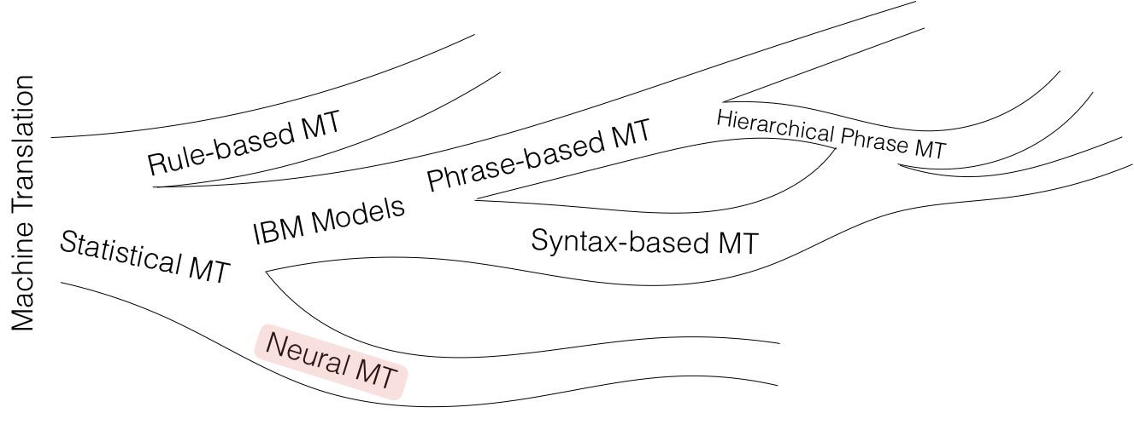

Slide 6
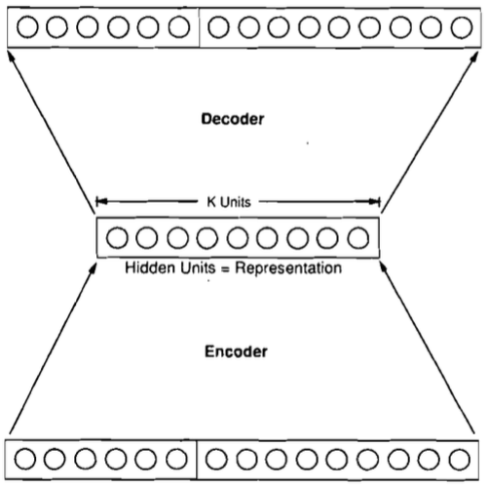
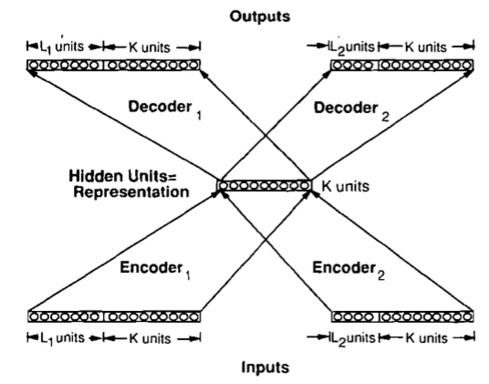
[Allen 1987 IEEE 1st ICNN]
3310 En-Es pairs constructed on 31 En, 40 Es words, max 10/11 word sentence; 33 used as test set
Binary encoding of words – 50 inputs, 66 outputs; 1 or 3 hidden 150-unit layers. Ave WER: 1.3 words
[Chrisman 1992 Connection Science]
Dual-ported RAAM architecture [Pollack 1990 Artificial Intelligence] applied to corpus of 216 parallel pairs of simple En-Es sentences:
Split 50/50 as train/test, 75% of sentences correctly translated!

Slide 7
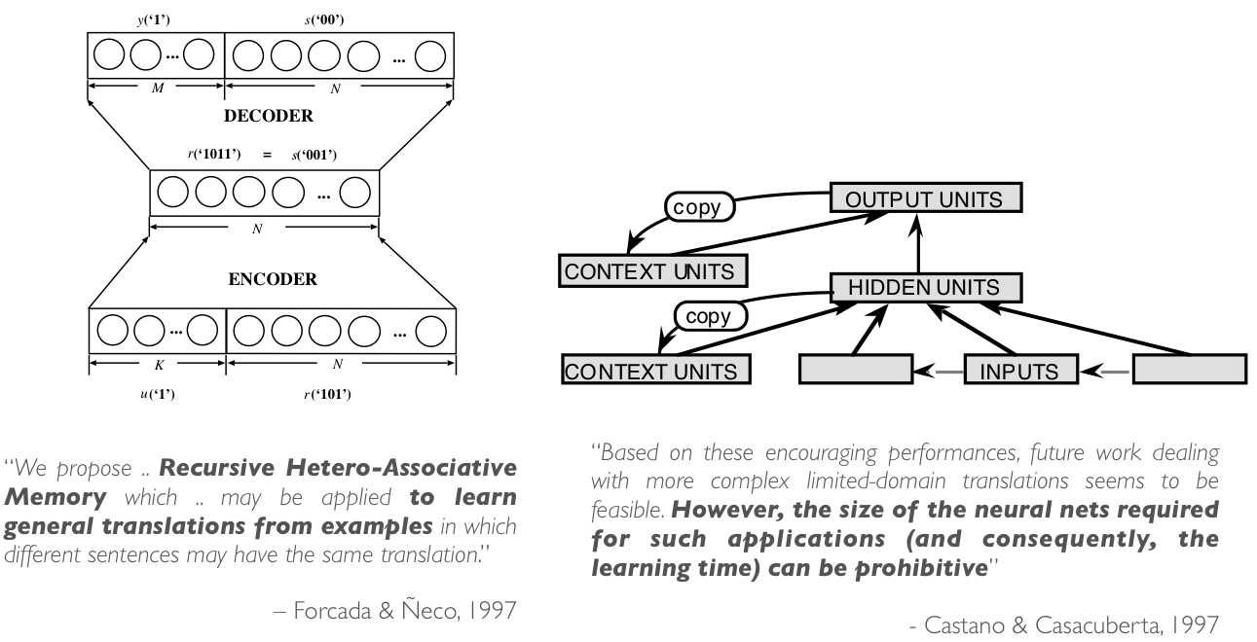
Brief resurrection in 1997

Slide 8
Modern neural machine translation

Slide 9
Machine Translation
Input: a sentence written in a source language
Output: a corresponding sentence in a target language
Problem statement:
Supervised learning: given the input sentence, output its translation
Compute the conditional distribution over all possible translation given the input
We have already learned every necessary ingredient for building a full neural machine translation system.

Slide 10
Token Representation – One-hot Vectors
Build source and target vocabularies of unique tokens
For each of source and target languages,
Tokenize: separate punctuations, normalize punctuations, … e.g., “I’m going” => (“I”, “’m”, “going”), replace ‘, ’, `, into “`”, … use Spacy.io, NLTK or Moses’ tokenizer.
Subword segmentation: segment each token into a sequence of subwords e.g., “going” => (“go”, “ing”), use BPE [Sennrich et al., 2015]
Collect all unique subwords, sort them by their frequencies (descending) and assign indices.
Transform each subword token into a corresponding one-hot vector.*
See Lecture 1.
* Of course, don’t do it offline. Transform them online.

Slide 11
Encoder – Source Sentence Representation
Encode the source sentence into a set of sentence representation vectors
# of encoded vectors is proportional to the source sentence length: often same.
Recurrent networks have been widely used [Cho et al., 2014; Sutskever et al., 2014], but CNN [Gehring et al., 2017; Kalchbrenner&Blunsom, 2013] and self-attention [Vaswani et al., 2017] are used increasingly more often. See Lecture 1 for details.
We do not want to collapse them into a single vector.
Collapsing often corresponds to information loss.
Increasingly more difficult to encode the entire source sentence into a single vector, as the sentence length increases [Cho et al., 2014b].
We didn’t know initially until [Bahdanau et al., 2015].

Slide 12
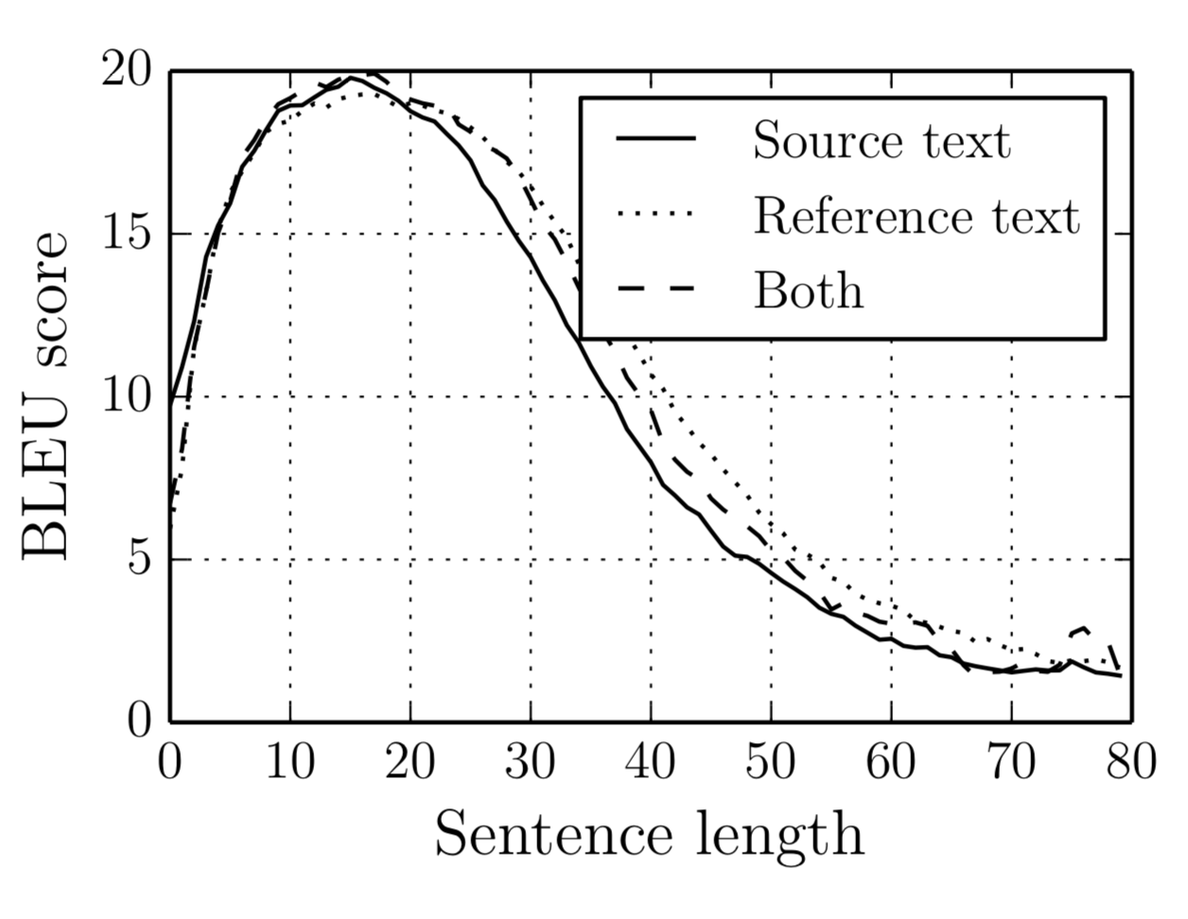
Encoder – Source Sentence Representation
Encode the source sentence into a set of sentence representation vectors
We do not want to collapse them into a single vector.
Increasingly more difficult to encode the entire source sentence into a single vector, as the sentence length increases [Cho et al., 2014b].

Slide 13
Encoder – Source Sentence Representation
Encode the source sentence into a set of sentence representation vectors
We do not want to collapse them into a single vector.
Increasingly more difficult to encode the entire source sentence into a single vector, as the sentence length increases [Cho et al., 2014b].
When collapsed, the system fails to translate a long sentence correctly.
Source: An admitting privilege is the right of a doctor to admit a patient to a hospital or a medical centre to carry out a diagnosis or a procedure, based on his status as a health care worker at a hospital.
When collapsed: Un privilège d’admission est le droit d’un médecin de reconnaître un patient à l’hôpital ou un centre médical d’un diagnostic ou de prendre un diagnostic en fonction de son état de santé.
The system translates reasonable up to a certain point, but starts drifting away.

Slide 14
Decoder – Language Modelling
Autoregressive Language modelling with an infinite context n→∞
Larger context is necessary to generate a coherent sentence.
Semantics could be largely provided by the source sentence, but syntactic properties need to be handled by the language model directly.
Recurrent networks, self-attention and (dilated) convolutional networks
Causal structure must be followed.
See Lecture 3.
Conditional Language modelling
The context based on which the next token is predicted is two-fold

Slide 15
Decoder – Conditional Language Modelling
Conditional Language modelling
The context based on which the next token is predicted is two-fold.
Supervised learning: T input-output training pairs per sentence
Input: the entire source sentence and the preceding target tokens
Output: the next token

Slide 16
Decoder – Conditional Language Modelling
Conditional Language modelling
?
Softmax
Source Sentence Representation
Target Sentence Representation

Slide 17
RNN Neural Machine Translation [Bahdanau et al., 2015]
Source sentence representation
A stack of bidirectional RNN’s
The extracted vector at each location is a context-dependent vector representation.
?
Softmax
Source Sentence Representation
Concat
RNN
RNN
RNN
Target Sentence Representation
RNN
RNN
RNN

Slide 18
RNN Neural Machine Translation [Bahdanau et al., 2015]
?
Target prefix representation
A unidirectional recurrent network
Compression of the target prefix
Summarizes what has been translated so far
Softmax
Source Sentence Representation
RNN
RNN
RNN
Target Sentence Representation

Slide 19
RNN Neural Machine Translation [Bahdanau et al., 2015]
?
Attention mechanism
Which part of the source sentence is relevant for predicting the next target token?
Recall self-attention from Lecture 2
Softmax
Source Sentence Representation
Summation
Target Sentence Representation
Weighting
Function
RN

Slide 20
RNN Neural Machine Translation [Bahdanau et al., 2015]
?
Attention mechanism
Which part of the source sentence is relevant for predicting the next target token?
Time-dependent source context vector
Softmax
Source Sentence Representation
Summation
Weighting
Function
RN
Target Sentence Representation

Slide 21
RNN Neural Machine Translation [Bahdanau et al., 2015]
Fuse the source context vector and target prefix vector
Combines and into a single vector
Weighting
Function
Summation
Softmax
Source Sentence Representation
An arbitrary
sub-graph
RN
Target Sentence Representation

Slide 22
RNN Neural Machine Translation
Conceptual process
Encode: read the entire source sentence to know what to translate
Attention: at each step, decide which source token(s) to translate next
Decode: based on what has been translated and what need to be translated, predict the next target token.
Repeat 2-3 until the <end-of-sentence> special token is generated.

Slide 23
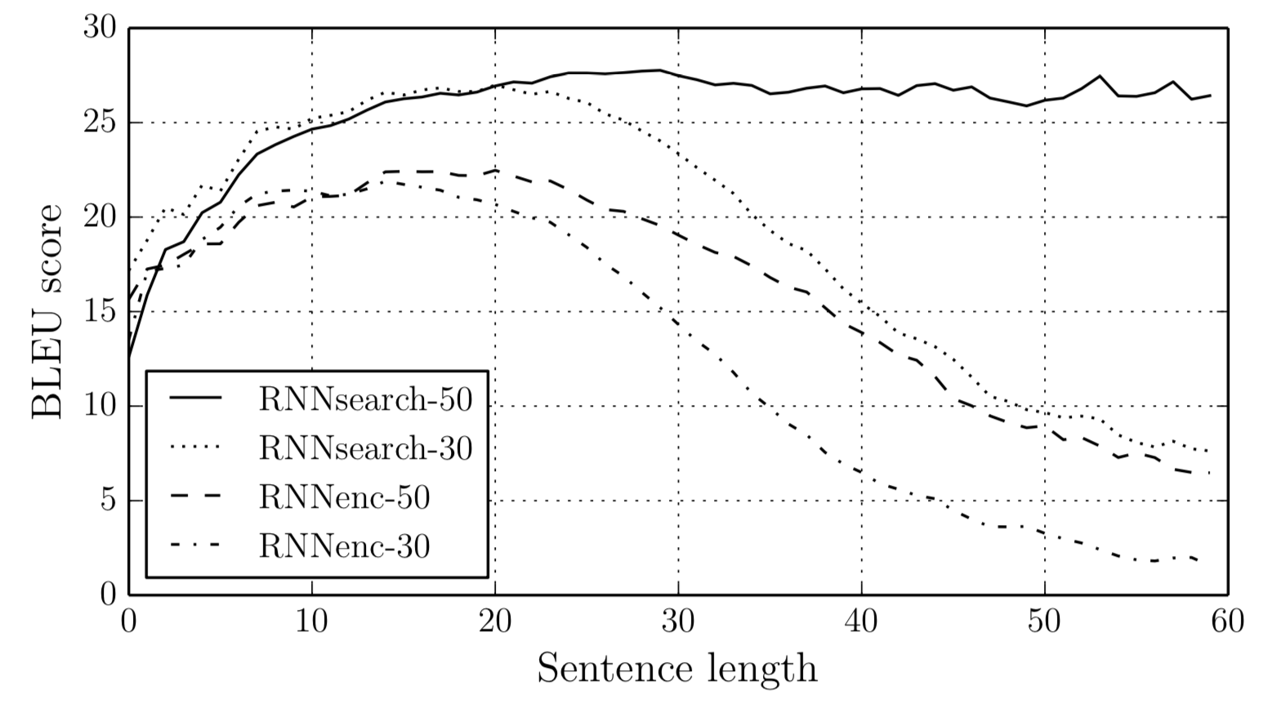
RNN Neural Machine Translation
The model is not pressured to compress the entire source sentence into a single, fixed-size vector:
Greatly improves the translation quality, especially of long sentences.
Much more efficient: less parameters are necessary.
Bahdanau et al. [2015] showed for the first time the machine translation purely based on neural networks could be as good as then-state-of-the-art alternatives (e.g., PBMT).

Slide 24
RNN Neural Machine Translation
Source: An admitting privilege is the right of a doctor to admit a patient to a hospital or a medical centre to carry out a diagnosis or a procedure, based on his status as a health care worker at a hospital.
When collapsed: Un privilège d’admission est le droit d’un médecin de reconnaître un patient à l’hôpital ou un centre médical d’un diagnostic ou de prendre un diagnostic en fonction de son état de santé.
RNNSearch: Un privilège d’admission est le droit d’un médecin d’admettre un patient à un hôpital ou un centre médical pour effectuer un diagnostic ou une procédure, selon son statut de travailleur des soins de santé à l’hôpital.

Slide 25
RNN Neural Machine Translation
Source: An admitting privilege is the right of a doctor to admit a patient to a hospital or a medical centre to carry out a diagnosis or a procedure, based on his status as a health care worker at a hospital.
When collapsed: Un privilège d’admission est le droit d’un médecin de reconnaître un patient à l’hôpital ou un centre médical d’un diagnostic ou de prendre un diagnostic en fonction de son état de santé.
RNNSearch: Un privilège d’admission est le droit d’un médecin d’admettre un patient à un hôpital ou un centre médical pour effectuer un diagnostic ou une procédure, selon son statut de travailleur des soins de santé à l’hôpital.

Slide 26
RNN Neural Machine Translation
Sensible alignment between source and target tokens
Capture long-range reordering/dependencies
Without strong supervision on the alignment
Weakly supervised learning
(Bahdanau et al., 2015; Jean et al., 2015)

Slide 27
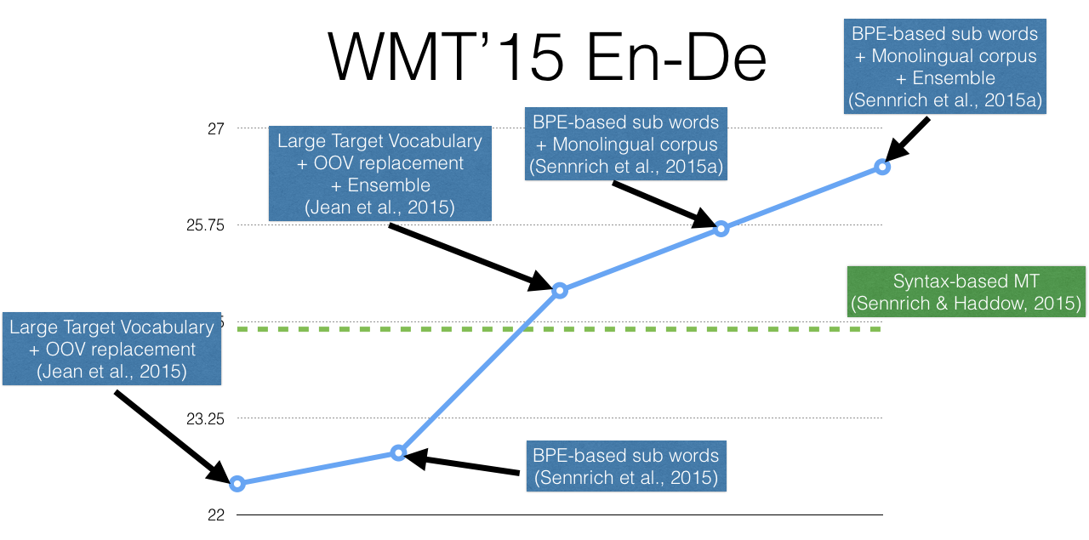
1 Year

Slide 28
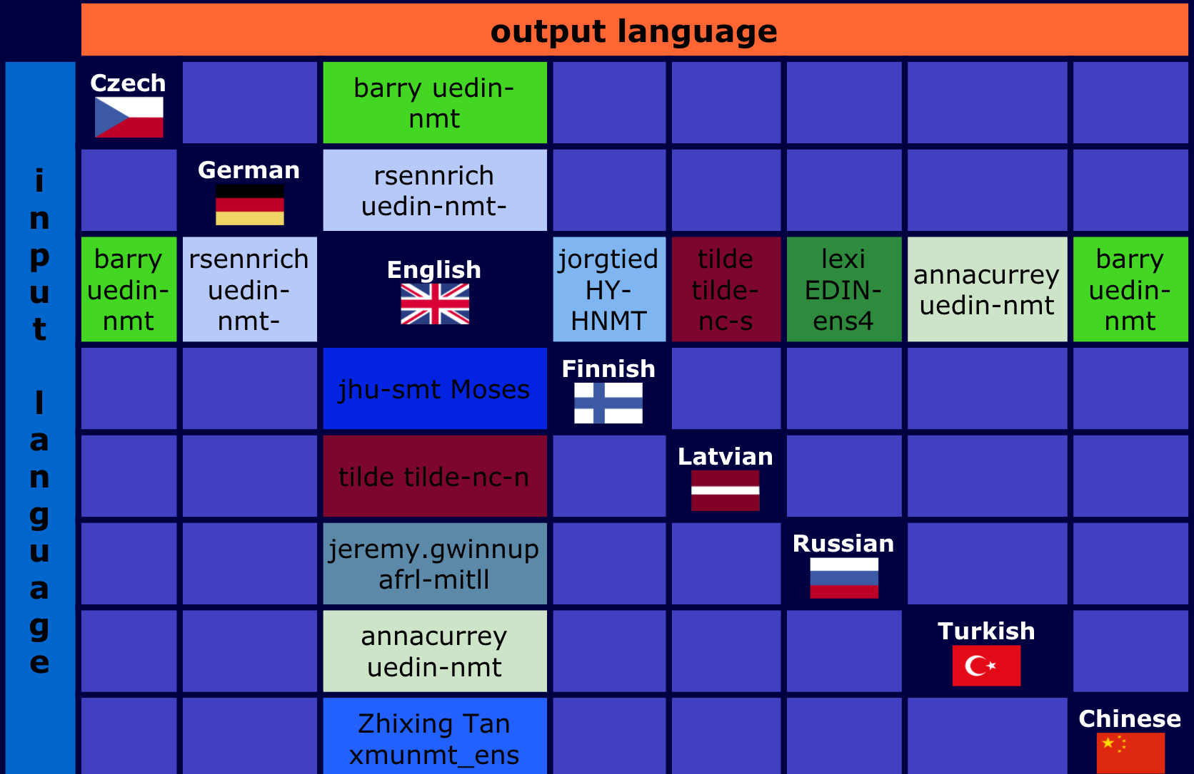
WMT 2017: news translation task

Slide 29
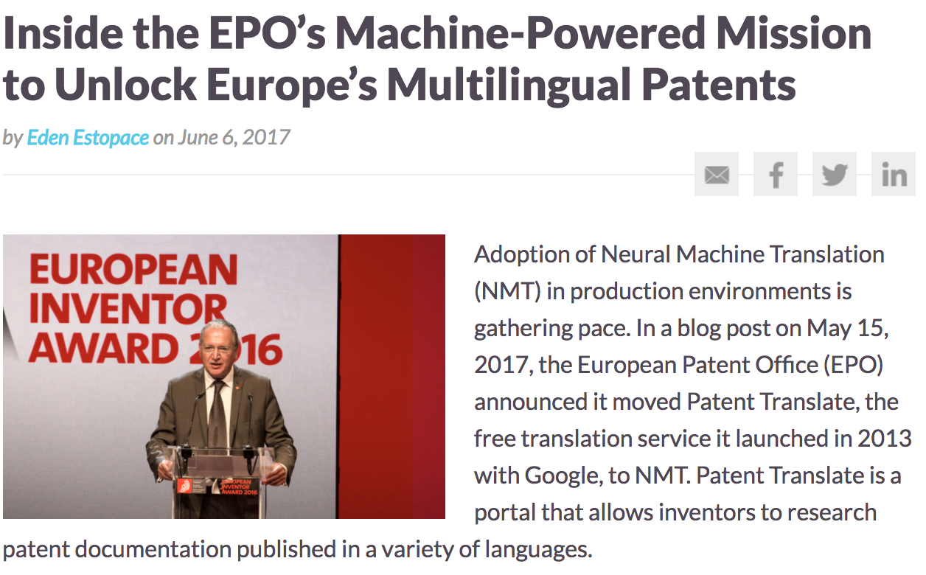
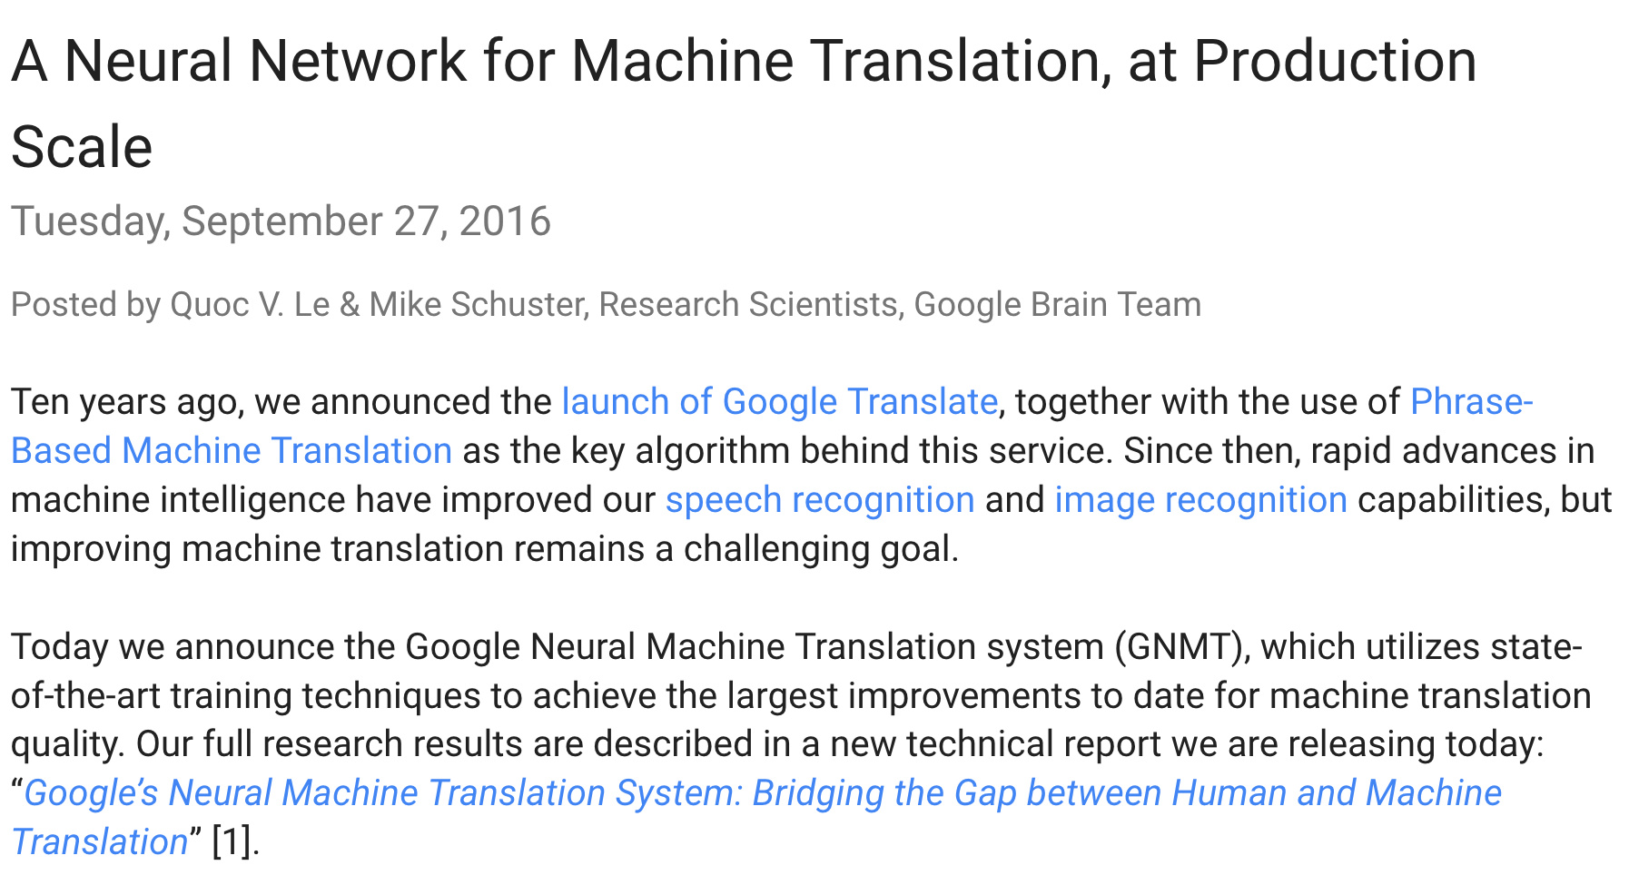

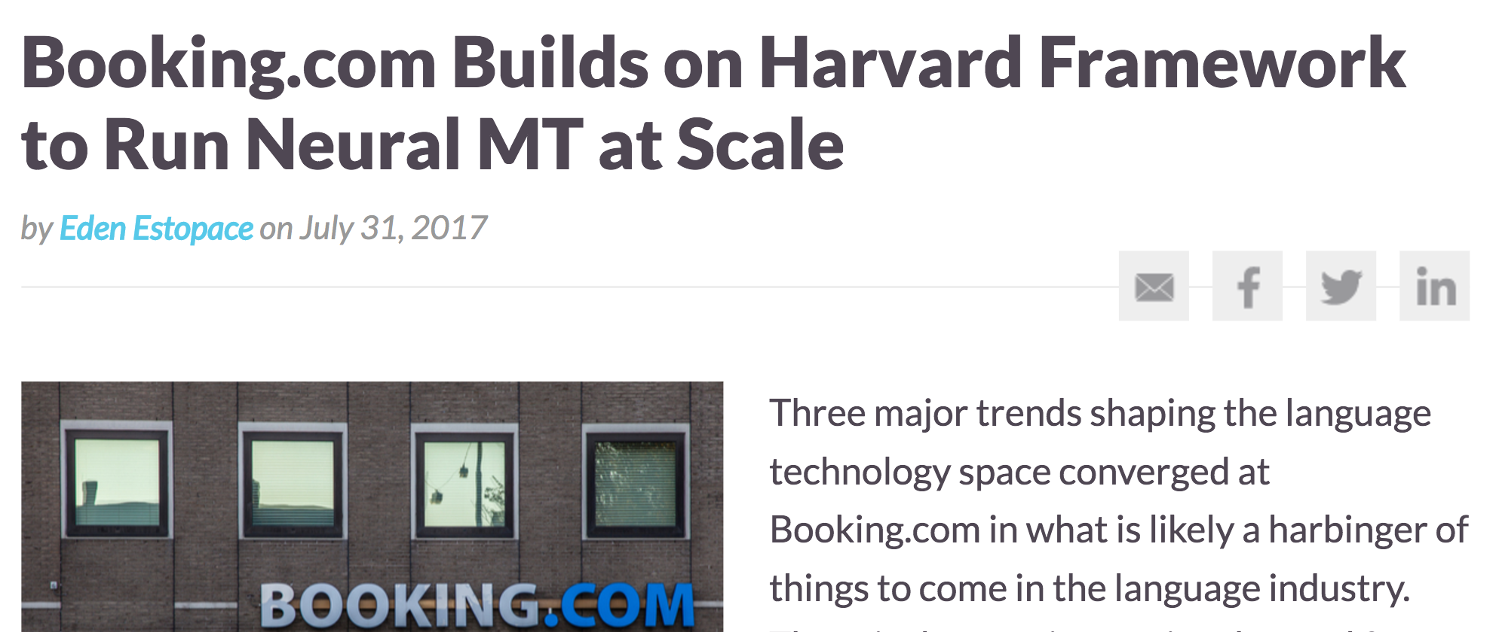
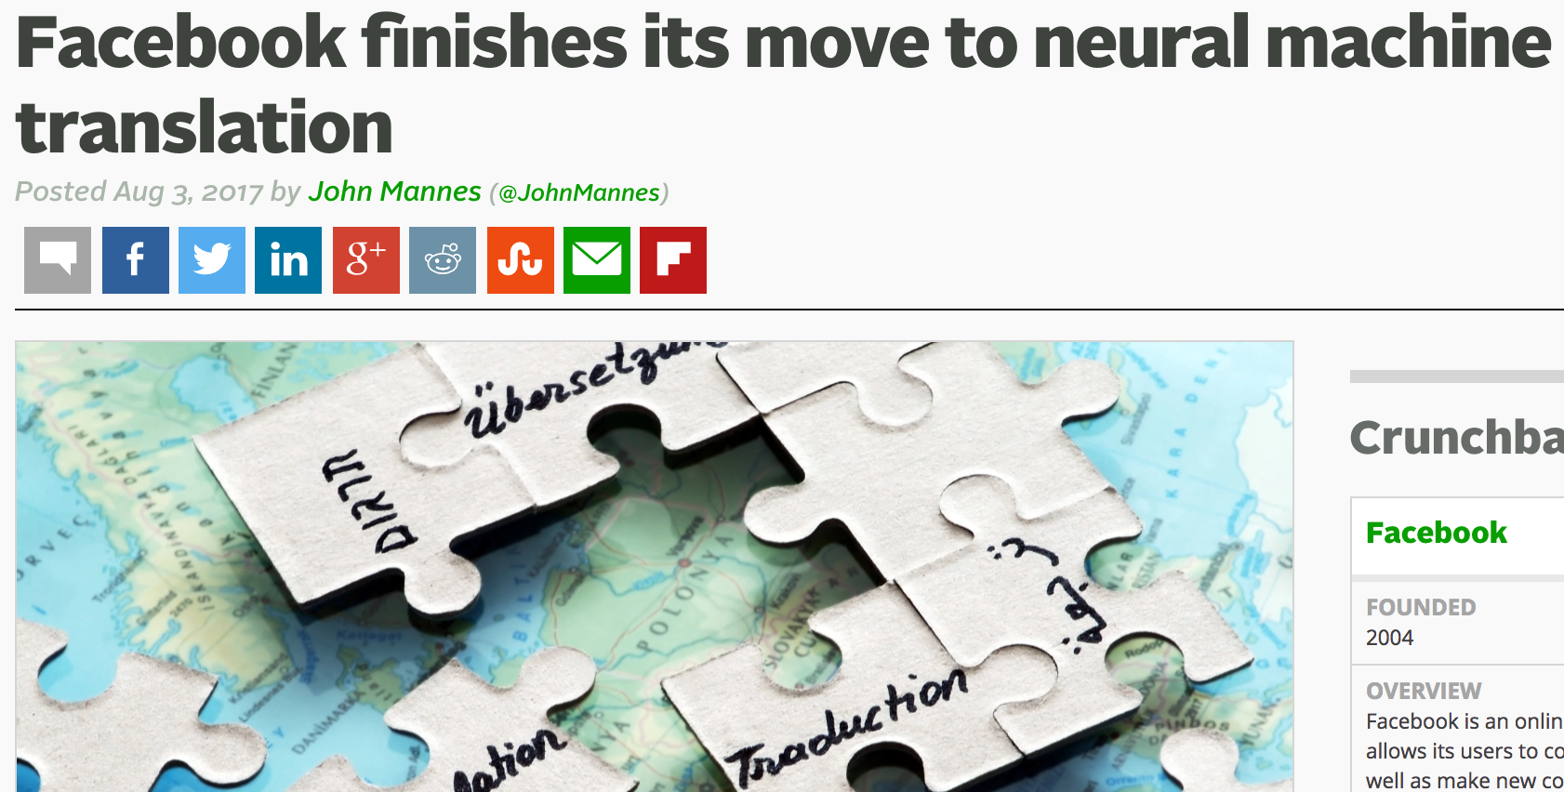
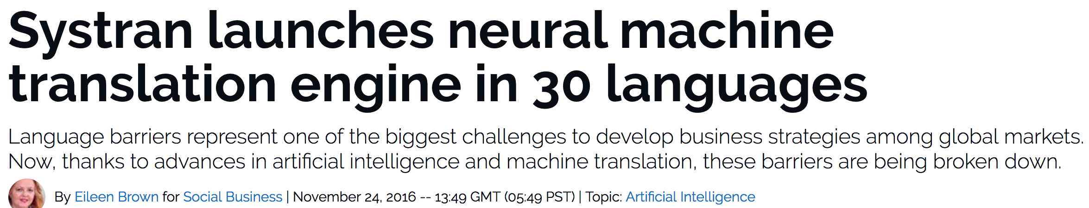
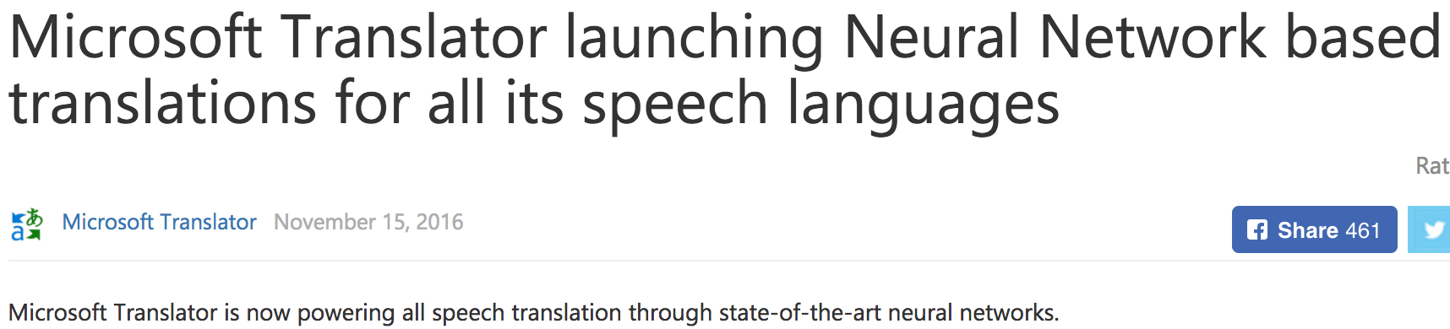

Slide 30

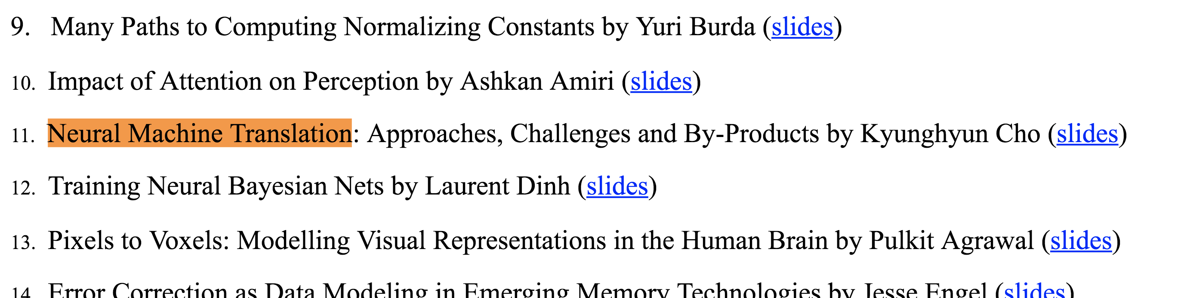
When was “neural machine translation” coined?

Slide 31
In practice,
Many excellent open-source packages exist:
Nematus https://github.com/EdinburghNLP/nematus
Compute backend: TensorFlow (originally Theano)
Used to build state-of-the-art translation systems for WMT’16 and WMT’17.
Supported by U. Edinburgh (Rico Sennrich’s group)
OpenNMT-py https://github.com/OpenNMT/OpenNMT-py
Compute backend: PyTorch (originally Lua-Torch)
Implements latest architectures and algorithms
Supported by Harvard NLP (Sasha Rush’s group)
FairSeq https://github.com/facebookresearch/fairseq
Compute backend: PyTorch
Focuses on the convolutional seq2seq
Supported by Facebook AI Research
Sockeye https://github.com/awslabs/sockeye
Compute backend: MXNet
Supported by Amazon

Slide 32
In practice,
Many new architectures are being proposed constantly
Convolutional sequence-to-sequence models [Gehring et al., 2017]
Encoder: CNN-based sentence representation
Decoder: CNN-based conditional language model
Transforms [Vaswani et al., 2017]
Encoder: Self-attention based sentence representation
Decoder: Self-attention based conditional language model
It has been four years only, and a long road lies ahead…

Slide 33
Further application – machine reading
Input: a paragraph + a question
Output: the position of the answer in the paragraph
Paragraph
Question
In meteorology, precipitation is any product of the condensation of atmospheric water vapor that falls under gravity. The main forms of precipitation include drizzle, rain, sleet, snow, graupel and hail... Precipitation forms as smaller droplets coalesce via collision with other rain drops or ice crystals within a cloud. Short, in- tense periods of rain in scattered locations are called “showers”.
What causes precipitation to fall?
SQuAD from [Rajpurkar et al., 2017]

Slide 34
Further application – machine reading
Encode the paragraph into a set of continuous vectors
e.g., use a bidirectional recurrent network.
Encode the question into a single, fixed-size vector
e.g., use a self-attention network followed by averaging.
Compare each token in the paragraph against the question using the RN module:
Turn the scores into a Categorical distribution using softmax.
Train it by maximizing the log-probability of the correct answer.
Nothing really changes other than the network architecture (DAG)

Slide 35
We’ve just learned
What machine translation is:
It maps a sentence in a source language into its translation in a target language.
What neural machine translation is:
A single neural network is used to approximate the entire translation process.
How to build an RNN neural machine translation system:
Encoder: a bidirectional RNN
Decoder: a unidirectional RNN coupled with the attention mechanism

Slide 36
From here on…
I will cover a few research projects as time permits:
Multilingual neural machine translation and meta-learning
Real-time translation
Character-level neural machine translation

